Slide 1
M-indicator chats analysis and notificaton
By ,
Saurabh Sahu
email-id : sahusaurabh65@gmail.com

Slide 2
Original data (.txt ) in .json format
Raw data
Labelled data
Mumbai railway staion
Train data
Test data
Class definations
Labelled train data
Mumbai_railway_stations

Slide 3
Approach and steps for implementing
Implementing all the basic steps of data preprocessing In NLP like : stemming, lemmatizing
Finding all the “wh-” type question that can be asked during the chats
Finding the relation among the words using parts of speech
Classifying whether the trains are meet to an accident or cancel or late
making our loops for showing a smart progress meter - just wrap any iterable by using tqdm .
Loading all the files
Making the files of greeting ,statement ,question, emotion ,y/n question
Corpus for finding sentiment of chats
Dividing the data into train and test
Naïve Bayes classifier
Spacy for visualization of project

Slide 4
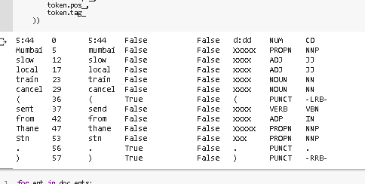

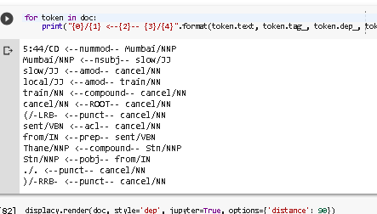

Deployment
By using spaCy
Accuracy of model

